Slide 1

How to Know What Career is Best For You

Slide 2
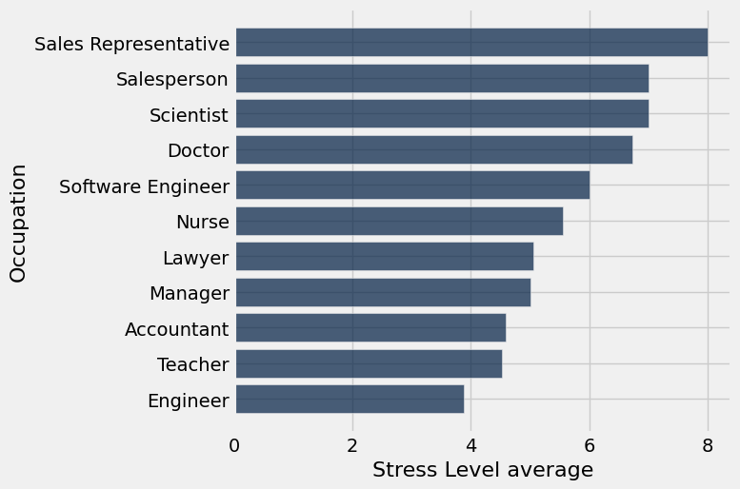
Which occupations are the most stressed?

Slide 3
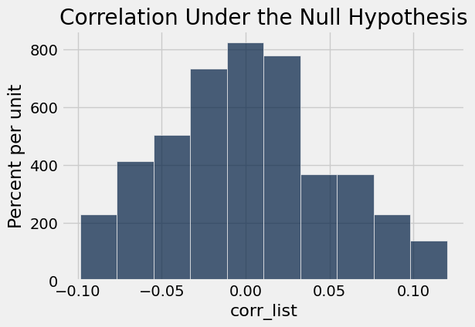
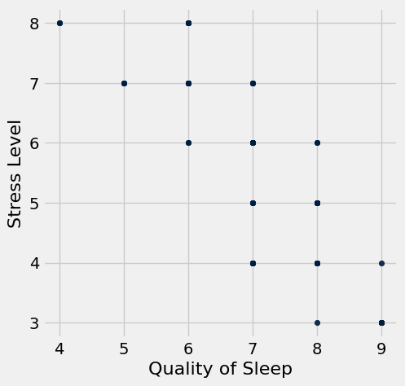
Permutation Test: Quality of Sleep vs. Stress Level
Observed correlation: -0.898752031004
p-value<0.001
-0.898752031004
Conclusion:
Layman’s version: there is strong evidence supporting the claim that higher sleep quality leads to lower stress levels.
Scientific version: assuming null hypothesis that there is no relationship between stress level and quality of sleep, the chance of seeing a difference at -0.899 or larger is less than 0.001. We reject the null hypothesis at a significance level of 0.001
H0: there is no association between Stress Level and Quality of Sleep
H1: Higher sleep quality leads to lower stress levels

Slide 4
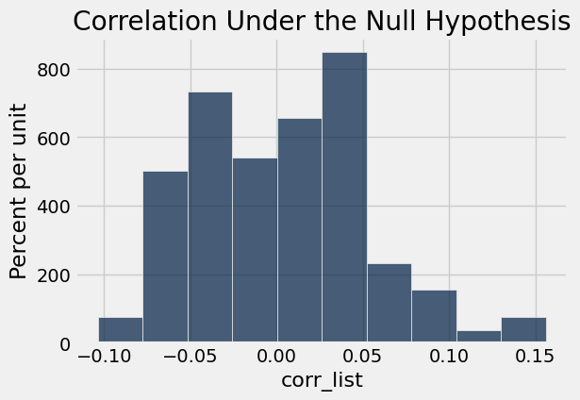
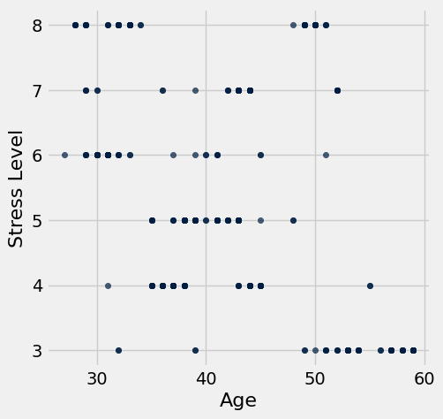
Permutation Test: Age vs. Stress Level
Observed correlation: -0.898752031004
p-value<0.001
-0.898752031004
Conclusion:
Layman’s version: there is strong evidence supporting the claim that older age is associated with lower stress level.
Scientific version: assuming null hypothesis that there is no relationship between age and stress level, the chance of seeing a difference at -0.899 or larger is less than 0.001. We reject the null hypothesis at a significance level of 0.001
H0: there is no association between Age and Stress Level
H1: Older age is associated with lower stress level and vice versa.

Slide 5
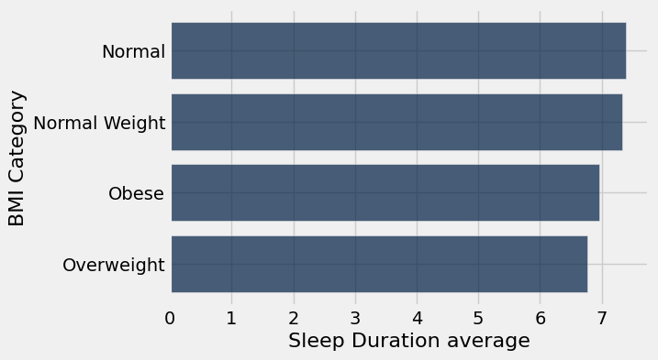
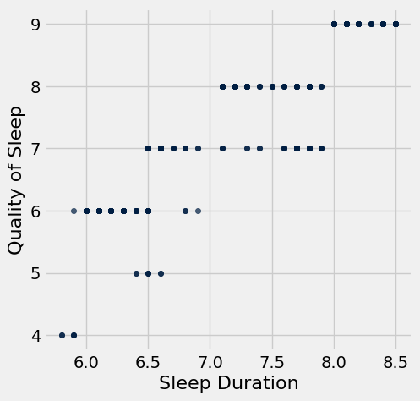
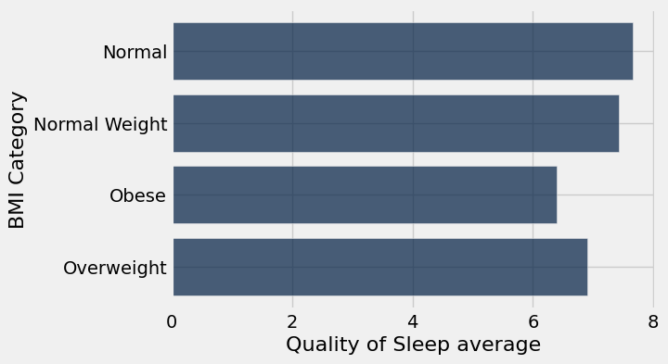
Data Insight: Overweight and Obese people sleep less and get poorer quality sleep than people with Normal weight.
BMI Category | count
Normal | 195
Normal Weight | 21
Obese | 10
Overweight | 148

Slide 6
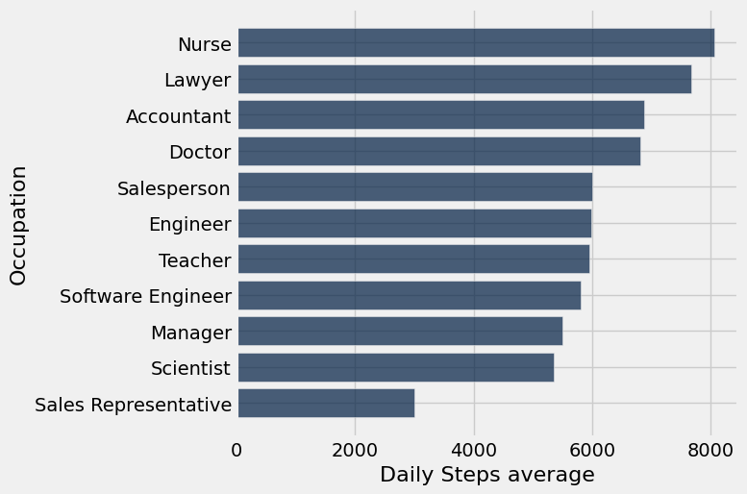
How do Daily Steps correlate with Stress Levels?

Slide 7
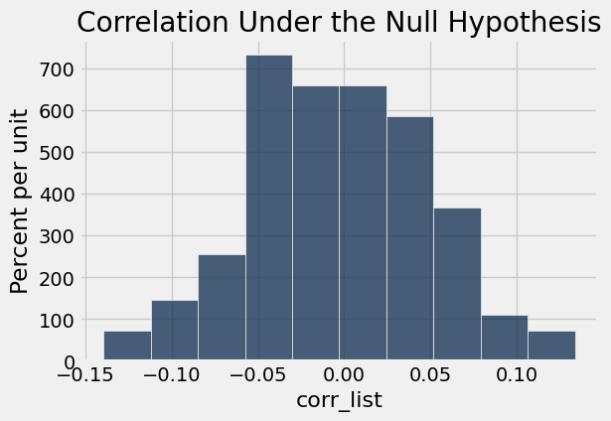
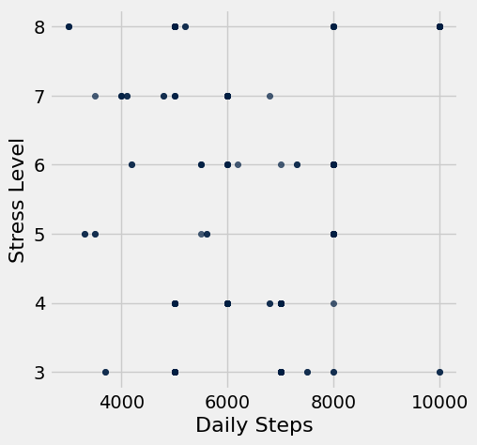
Permutation Test: Daily Steps vs. Stress Level
Observed correlation: 0.186828954459
p-value<0.001
0.186828954459
Conclusion:
Layman’s version: there is strong evidence supporting the claim that higher daily step count is associated with lower stress level.
Scientific version: assuming null hypothesis that there is no relationship between daily steps and stress level, the chance of seeing a difference at 0.186 or larger is less than 0.001. We reject the null hypothesis at a significance level of 0.001
H0: there is no association between Daily Steps and Stress Level
H1: Higher Daily Steps is associated with lower Stress Level and vice versa.

Slide 8
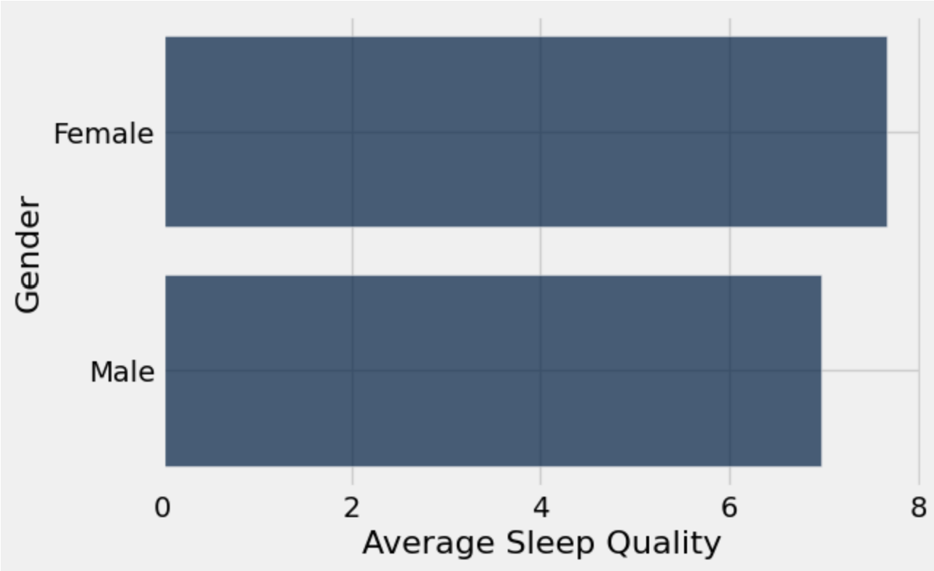
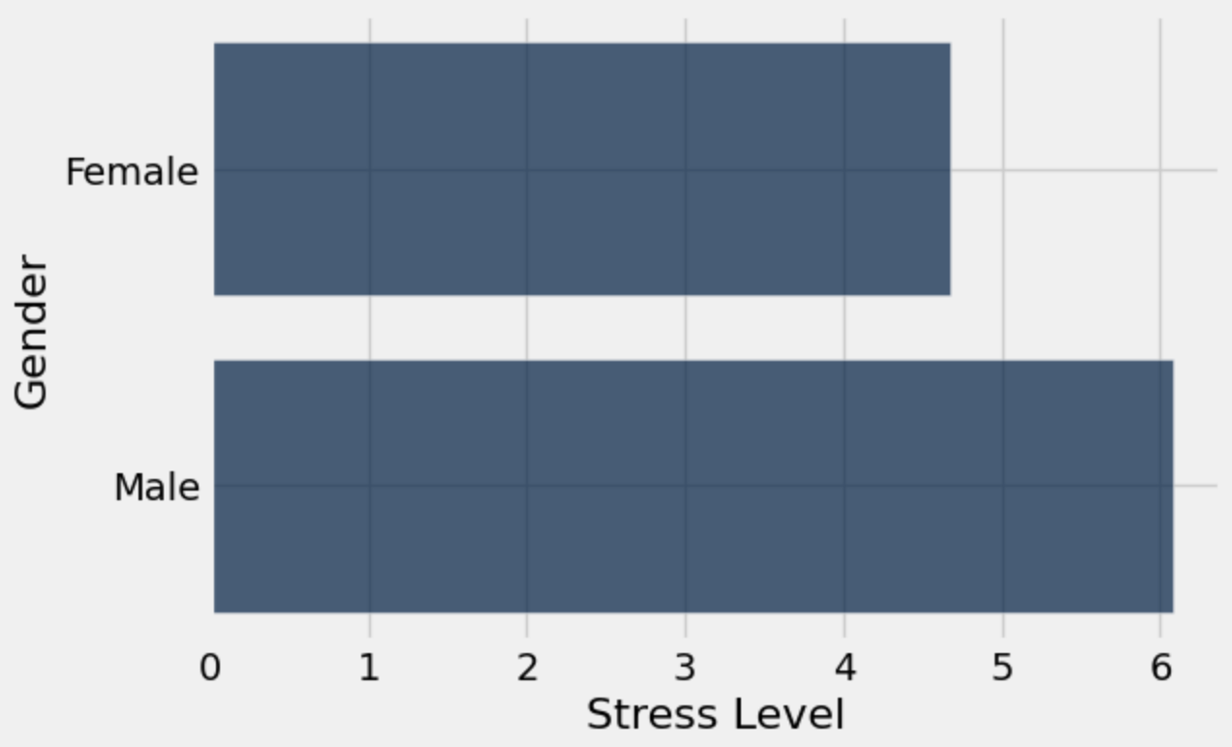
How Gender Impacts Average Sleep and Stress Levels in ALL Fields

Slide 9
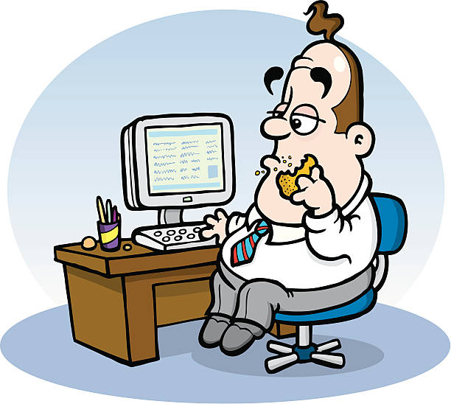
By Brittany Huynh
Average Male Salesperson Data 👨🏻‍💼
35 Years Old
5 out of 10 Sleep Quality Score 💤
7.5 out of 10 Stress Level Score 🧘🏻‍♂️
4500 Daily Steps 🏃🏻‍♂️
37.5 Physical Activity Level
Overweight (BMI 25 to 29.9)
https://www.istockphoto.com/vector/fat-office-worker-at-his-desk-gm163855785-13816944
Link to source
Male Salespersons are the most stressed individuals in this dataset. They live relatively unhealthy lifestyles with a low overall sleep quality score, a low-normal level of daily physical activity, and are overweight.
(Based on the data of 32 male salespersons)

Slide 10

By Brittany Huynh
Average Female Engineer Data 🛠️
53 Years Old
9 out of 10 Sleep Quality Score 💤
3 out of 10 Stress Level Score 🧘🏻‍♀️
5000 Daily Steps 🏃🏻‍♀️
30 Physical Activity Level
Normal Weight (BMI 18.5-24.9)
https://iheartcraftythings.com/cartoon-woman-drawing.html
Link to source
Female engineers are the least stressed individuals in this dataset. They also live relatively healthy lifestyles with a high overall sleep quality score, a normal level of daily physical activity, and normal weight BMI category.
(Based on the data of 32 female engineers)

